Slide 1
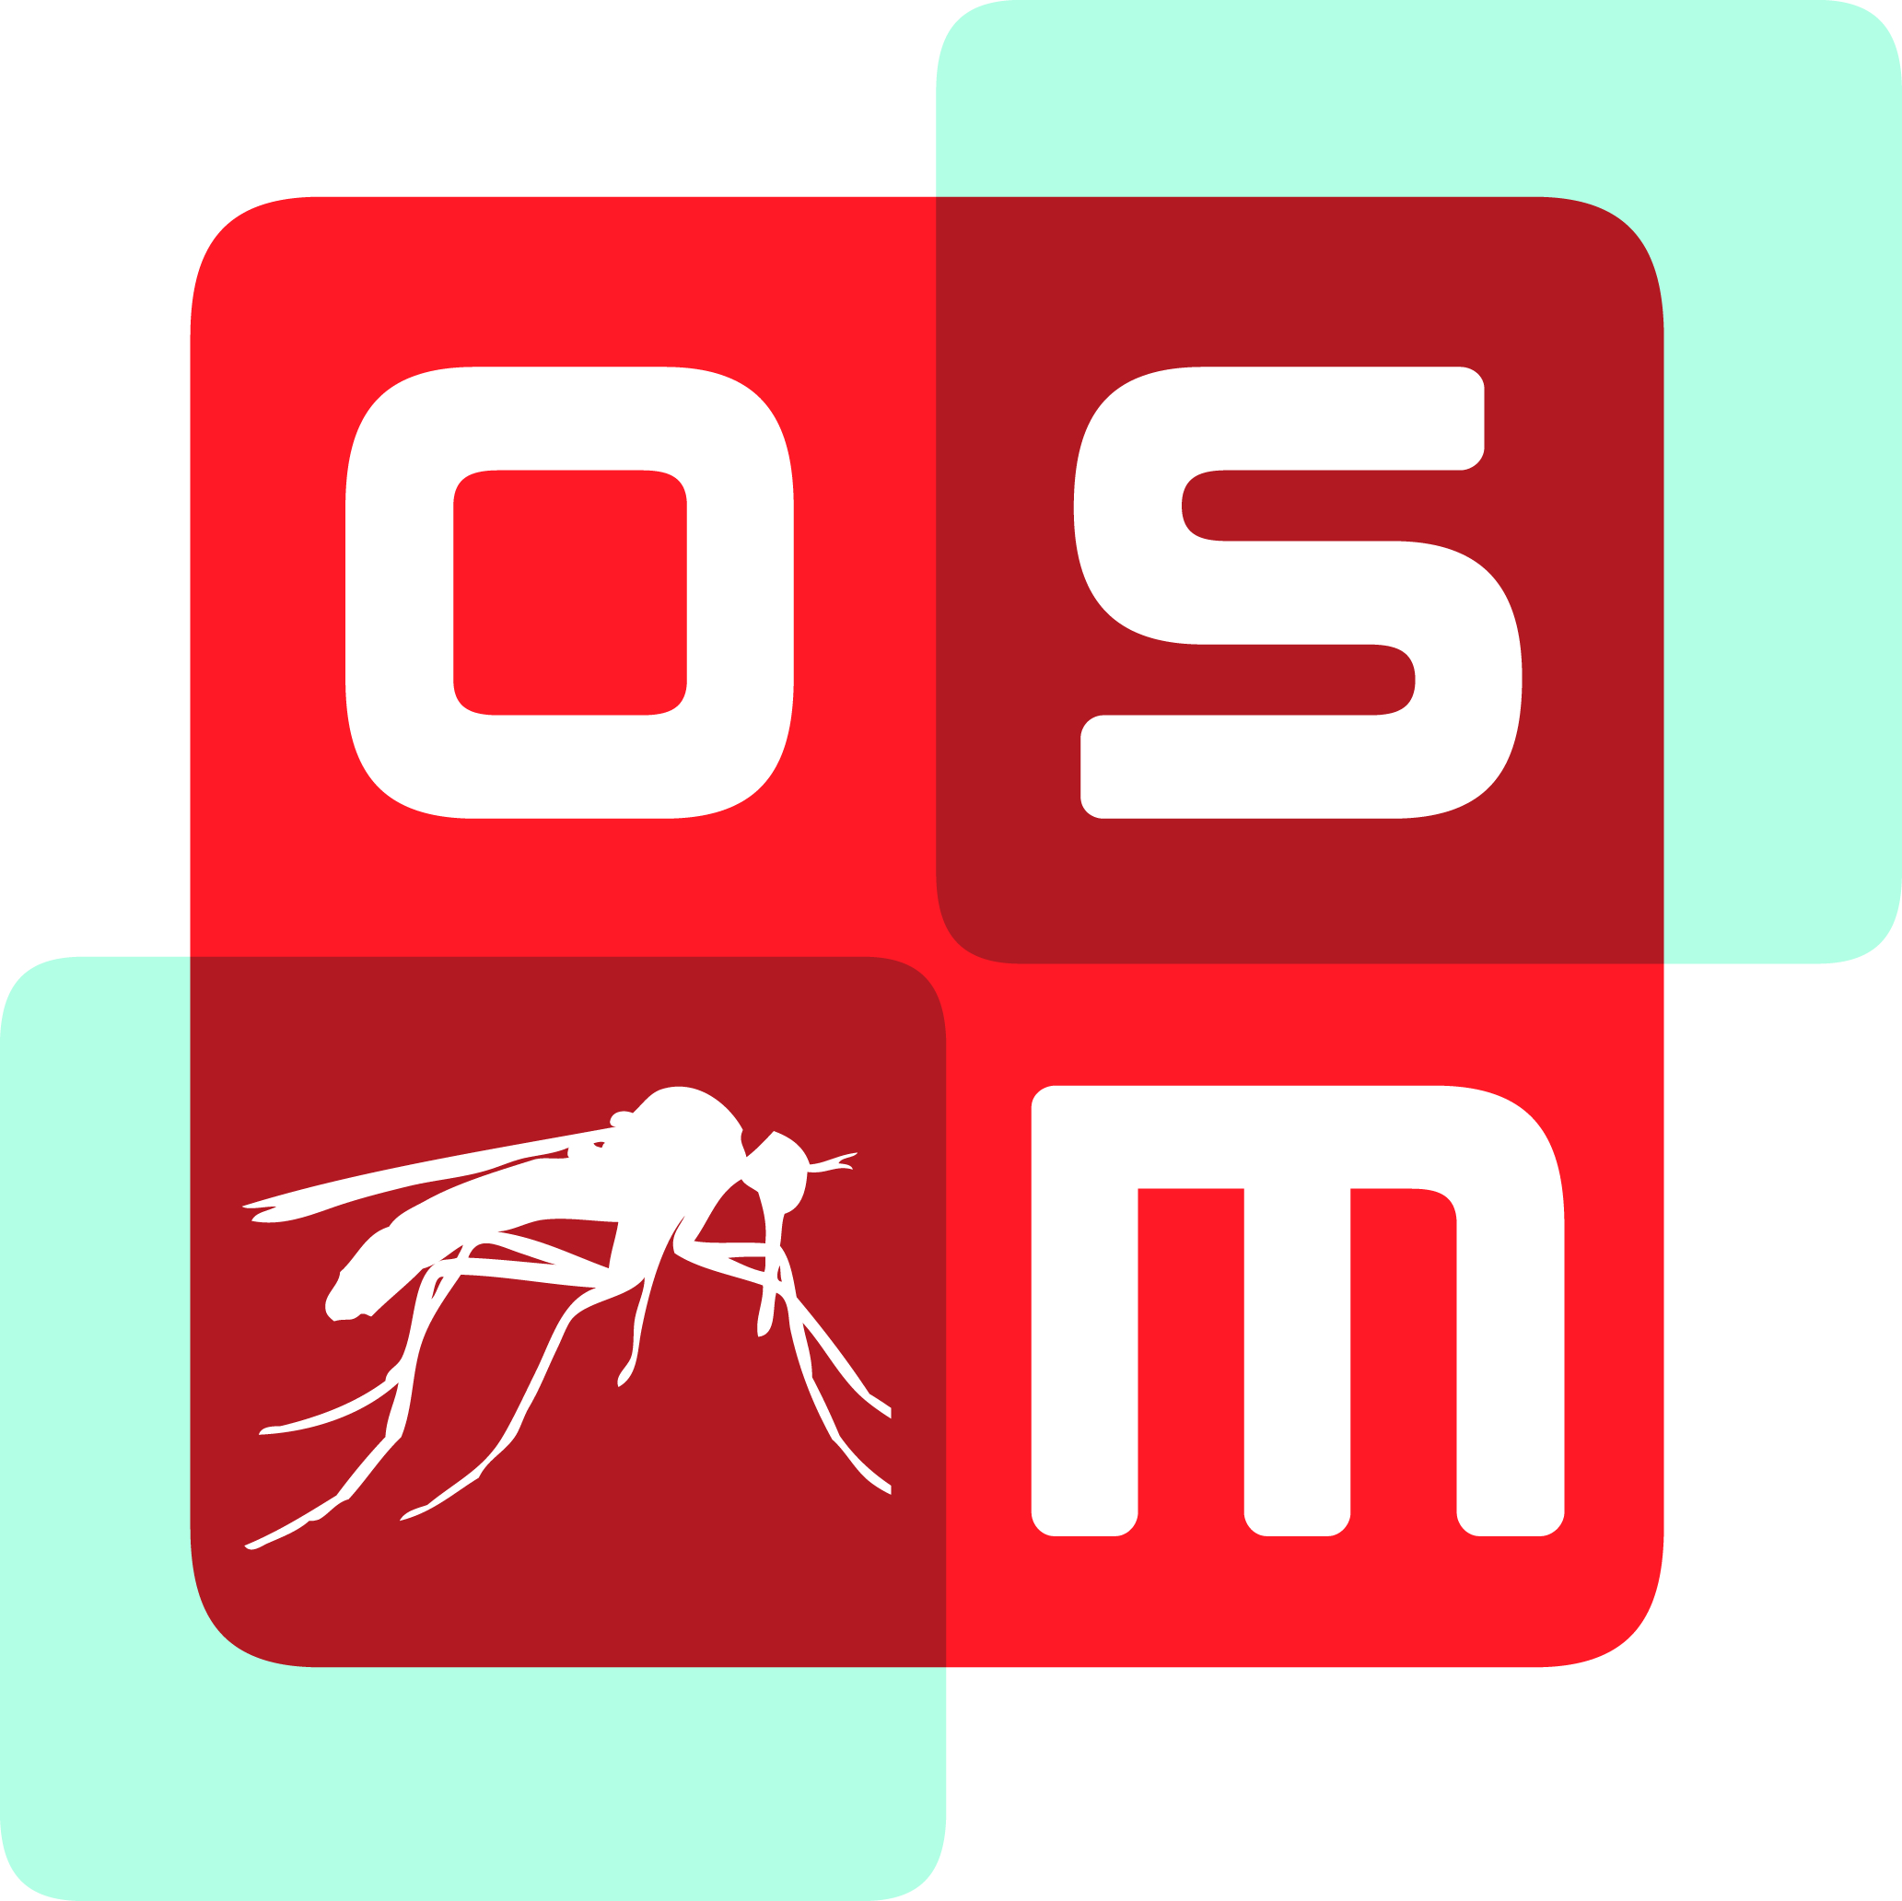
“I Like Not Fair Terms and a Villain’s Mind”
Incentives for Openness in Biomedical Research
Prof Matthew H. Todd, University College London
@mattoddchem
Beilstein Institute Meeting, Making Science FAIR, Rüdesheim
October 8th 2018
Today
1) Our Report Card at FAIR in OSM
2) What this does to the Economics of Drug Discovery

Slide 2
2/55
39/58
Two Common Things Scientists Will Say
The FAIR requirements are annoying. I can’t be bothered
and
2) If I open up the research, people will scoop me. And profit
“I Like Not Fair Terms…”
“…and a Villain’s Mind”

Slide 3



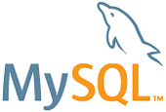
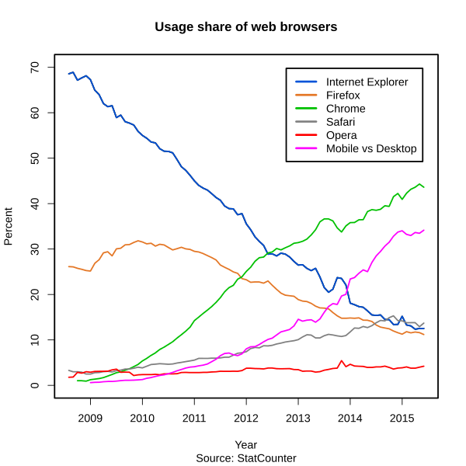

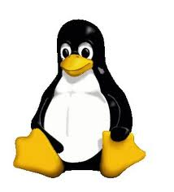
3/55
Data vs. Process: Open Source
A $5 Billion Value: Estimating the Total Development Cost of Linux Foundation’s Collaborative Projects, The Linux Foundation Report 2015 (Thanks Bill Hooker (https://twitter.com/sennoma/status/658816532147900416))
https://en.wikipedia.org/wiki/File:Usage_share_of_web_browsers_%28Source_StatCounter%29.svg

Slide 4
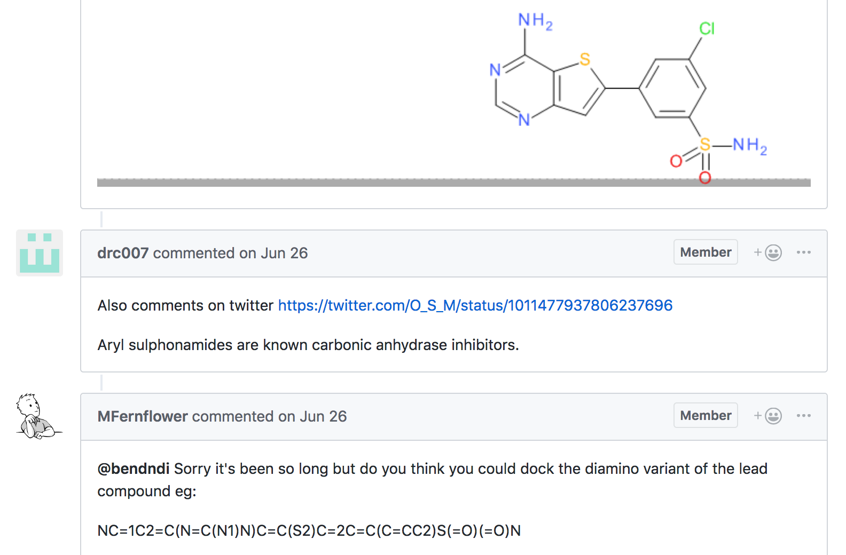
4/55
39/58
FAIR Technically Applies to Data
But Data and the Project are Tightly Linked

Slide 5
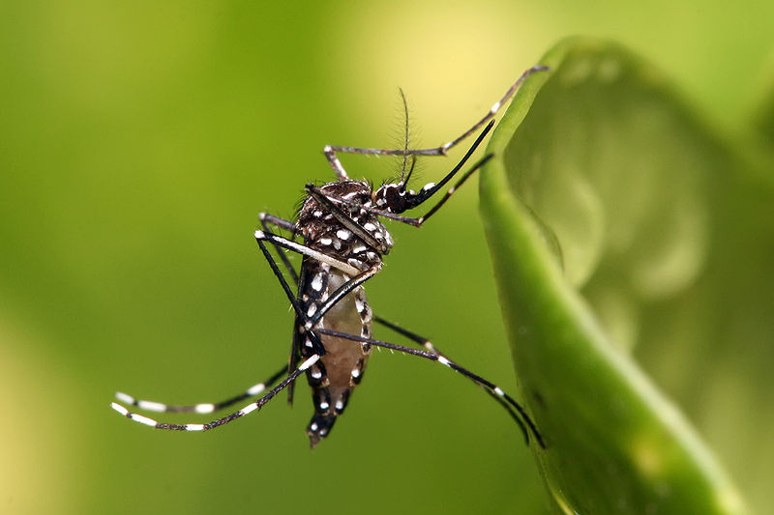



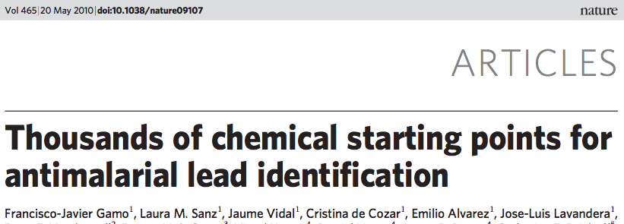


5/55
HIT
LEAD?
CONVENTIONAL DRUG DISCOVERY

Slide 6
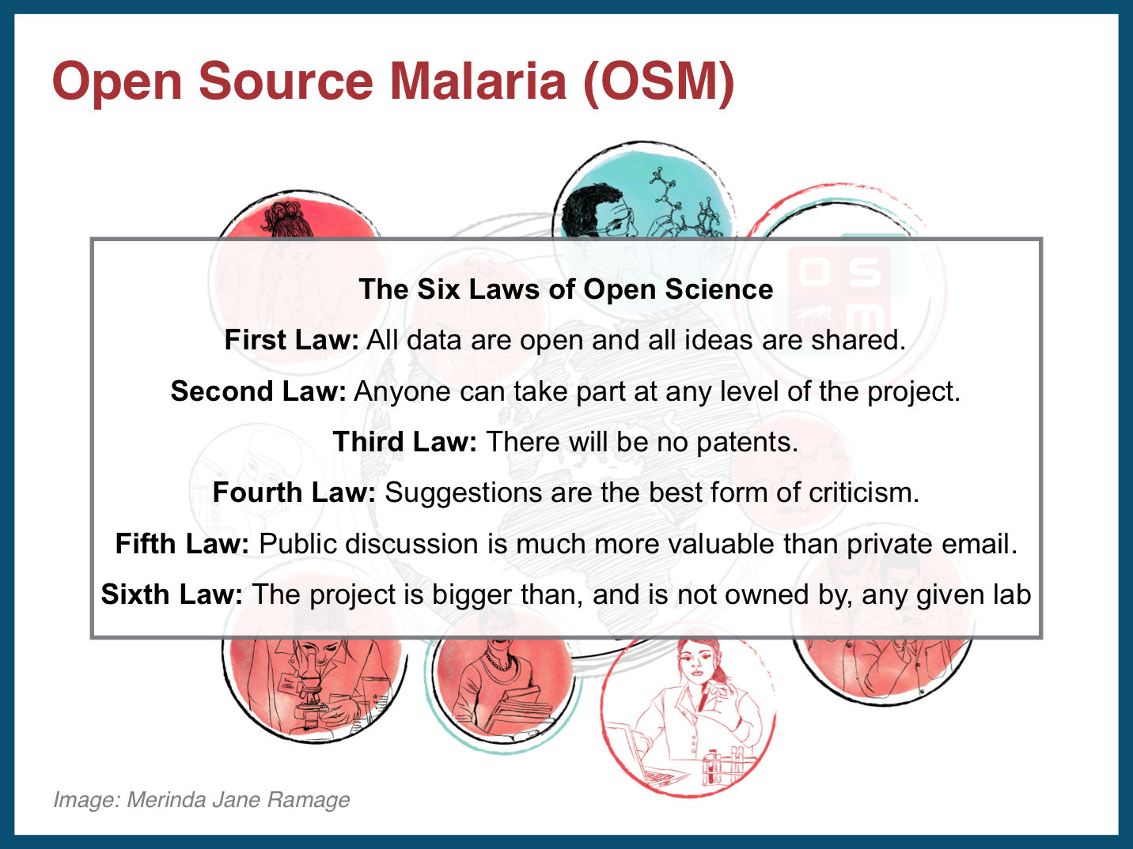
6/55

Slide 7


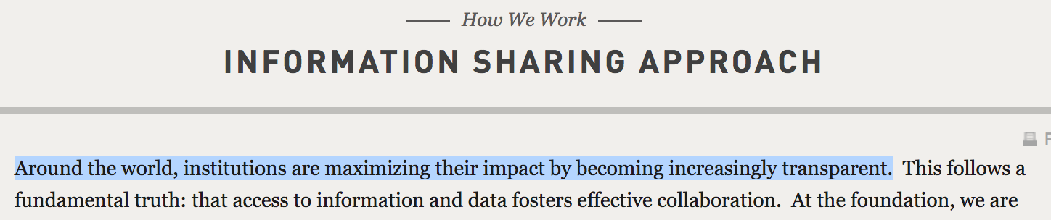
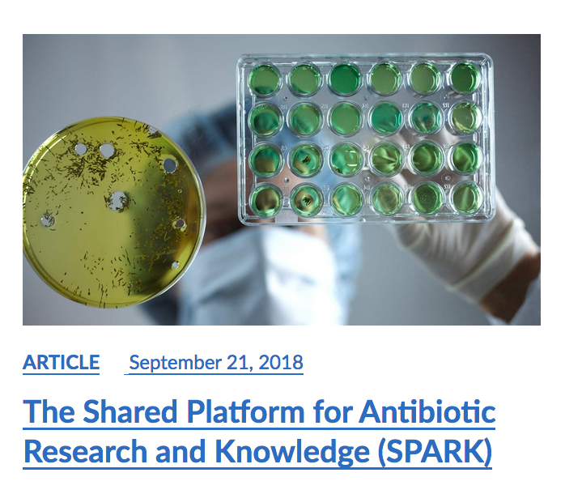
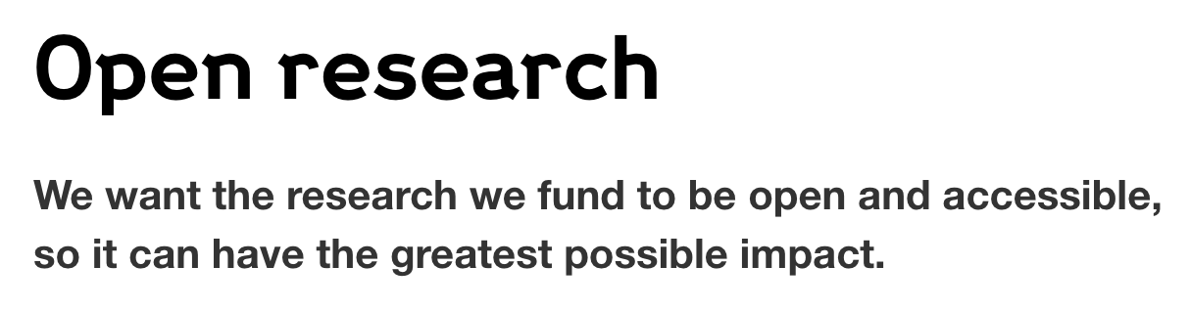
7/55
Openness Key to New Medicines
Open Source Malaria
Structural Genomics Consortium
MMV’s Malaria Box
BMGF
Wellcome Trust
Pew Trusts

Slide 8
OSM - Four Campaigns So Far
8/55
Series typically not exhausted - Decision points made to move to another.
Anyone free to employ OSM infrastructure to explore these series
www.opensourcemalaria.org, @O_S_M

Slide 9
Current sub-100 nM hits
9/55

Slide 10
Current Target and Status
10/55

Slide 11
11/55
Next Targets for OSM
17/18
Specific
Scientific: Series into Preclinical Trials
Community: More official industry pro bono
Crowd: Federated/franchised student projects in synthesis
Content: Community-contributed “parked” or “static” series
Platform: many technical things
Broader Investments
Regulatory Superstructure
Other Disease-specific Projects
Scalable Crowd Management

Slide 12
12/55
Report Card: Findable?
17/18
B+
Data, project easy to find.
Maximal persistence of resources
Current issues are written up and assigned to people
But data not well folded in, so it’s hard to understand from outside
Cells of project are not well interlinked

Slide 13
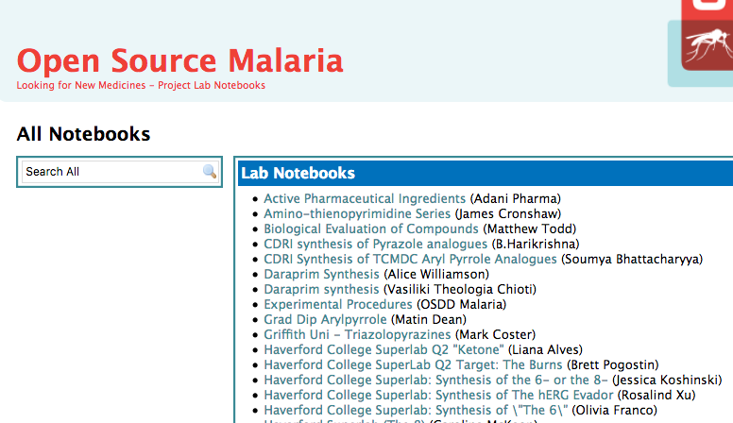
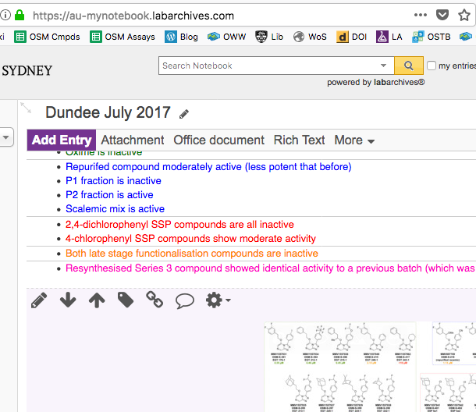
What Actually Is OSM?
13/55
Beta - Labarchives
Alpha - Labtrove
Electronic Lab Notebook
Real-time, open deposition of all research data. The bedrock. Entries have persistent identifiers, e.g. DOIs

Slide 14
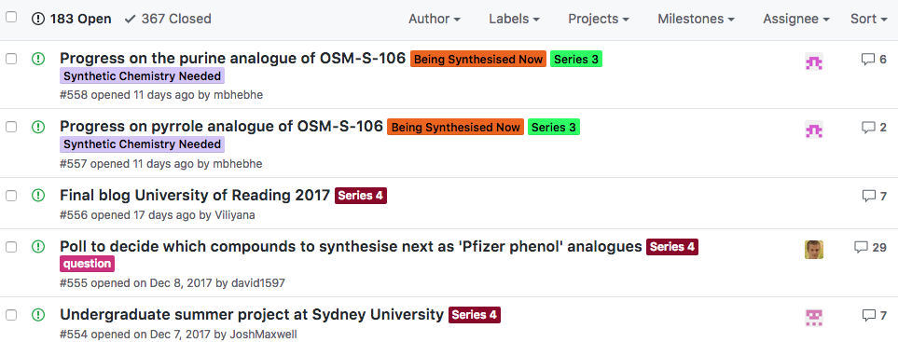
What Actually Is It?
14/55
Discussion/Wiki/To Do List
We’ve hijacked/repurposed Github, but don’t know what we’re doing
https://github.com/OpenSourceMalaria

Slide 15
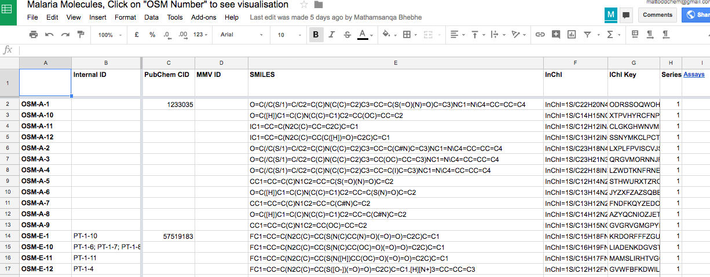
What Actually Is It?
15/55
Open Data
Details of all molecules and their potencies. Easy to reuse.
http://tinyurl.com/OSM-Compounds

Slide 16
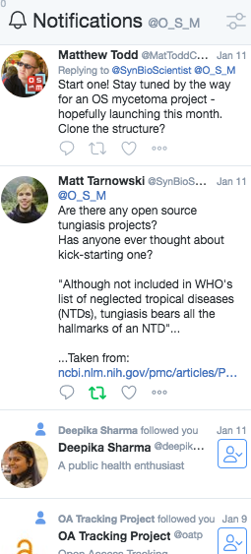
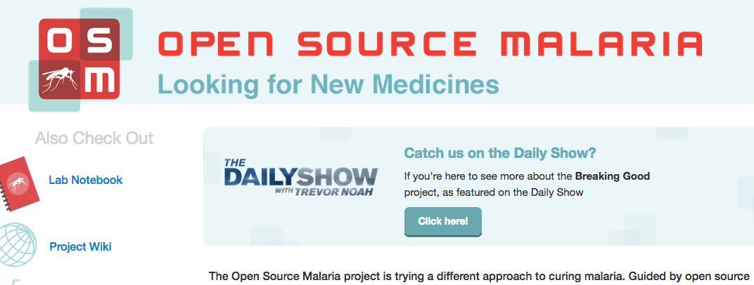
What Actually Is It?
16/55
Landing Page, SocMed
Need to be discovered, and to reach out to people.
http://opensourcemalaria.org/
@O_S_M

Slide 17
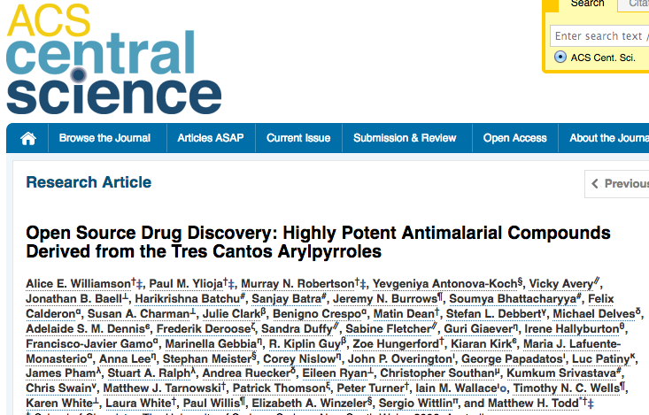
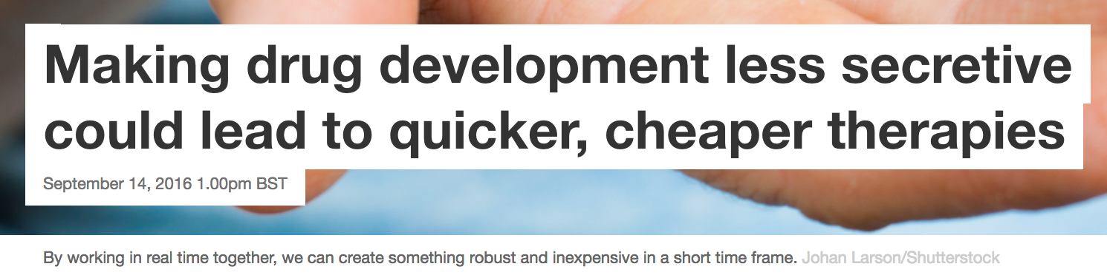
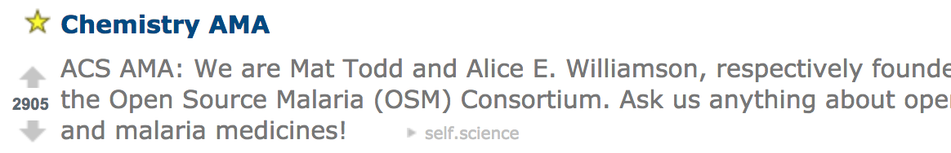
17/55
YES
…
you can publish
Paper: ACS Cent. Sci. 2016, 2, 687–701
Platform: Chem. Sci. 2015, 6, 1614–1629; Parasitology 2014, 141, 148–157
The Conversation, Sept 14th 2016
Reddit Ask Me Anything, Oct 4th 2016

Slide 18
18/55
Report Card: Accessible?
B–
Easy to work with the consortium of people
Examples of crowdsourcing, spontaneous inputs
Still relies on human gatekeepers/shepherds
Automatic metadata generation not great

Slide 19

19/55
Highly amenable to
Crowdsourced, Open Educational Initiatives
Nov ’12
Apr ‘13
Nov ‘14
Feb ‘15
Oct ‘15
Mar ‘16
Jun ‘16
’18 –

Slide 20
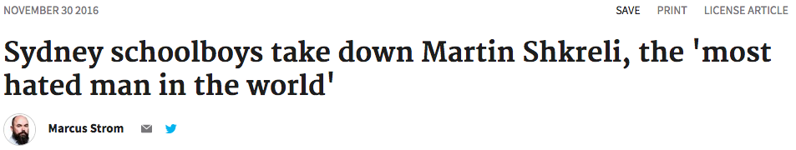
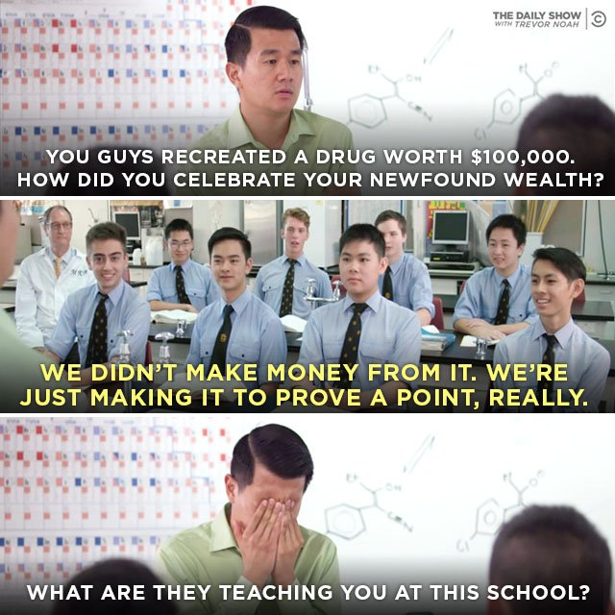
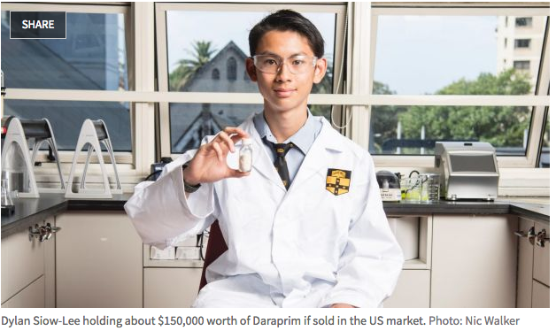
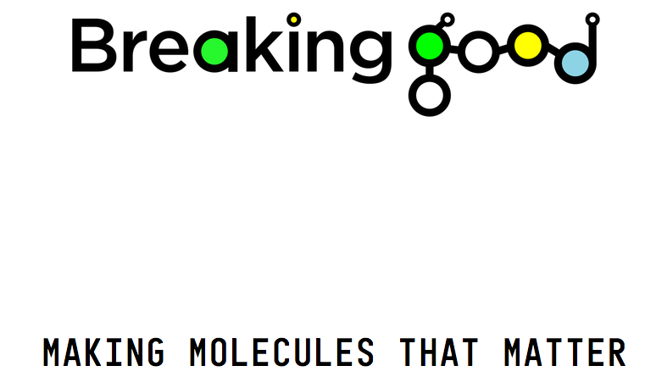
“Breaking Good”
20/55

Slide 21
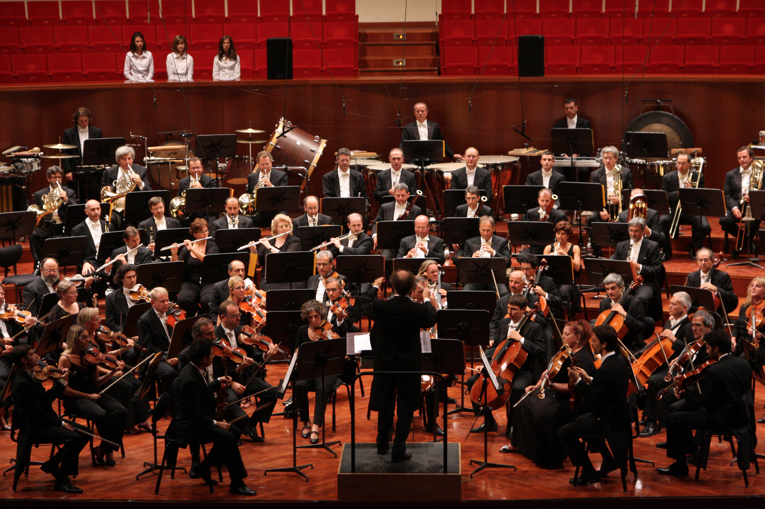
Spectatorism, engagement
21/55
https://upload.wikimedia.org/wikipedia/commons/3/39/MITO_Orchestra_Sinfonica_RAI.jpg

Slide 22
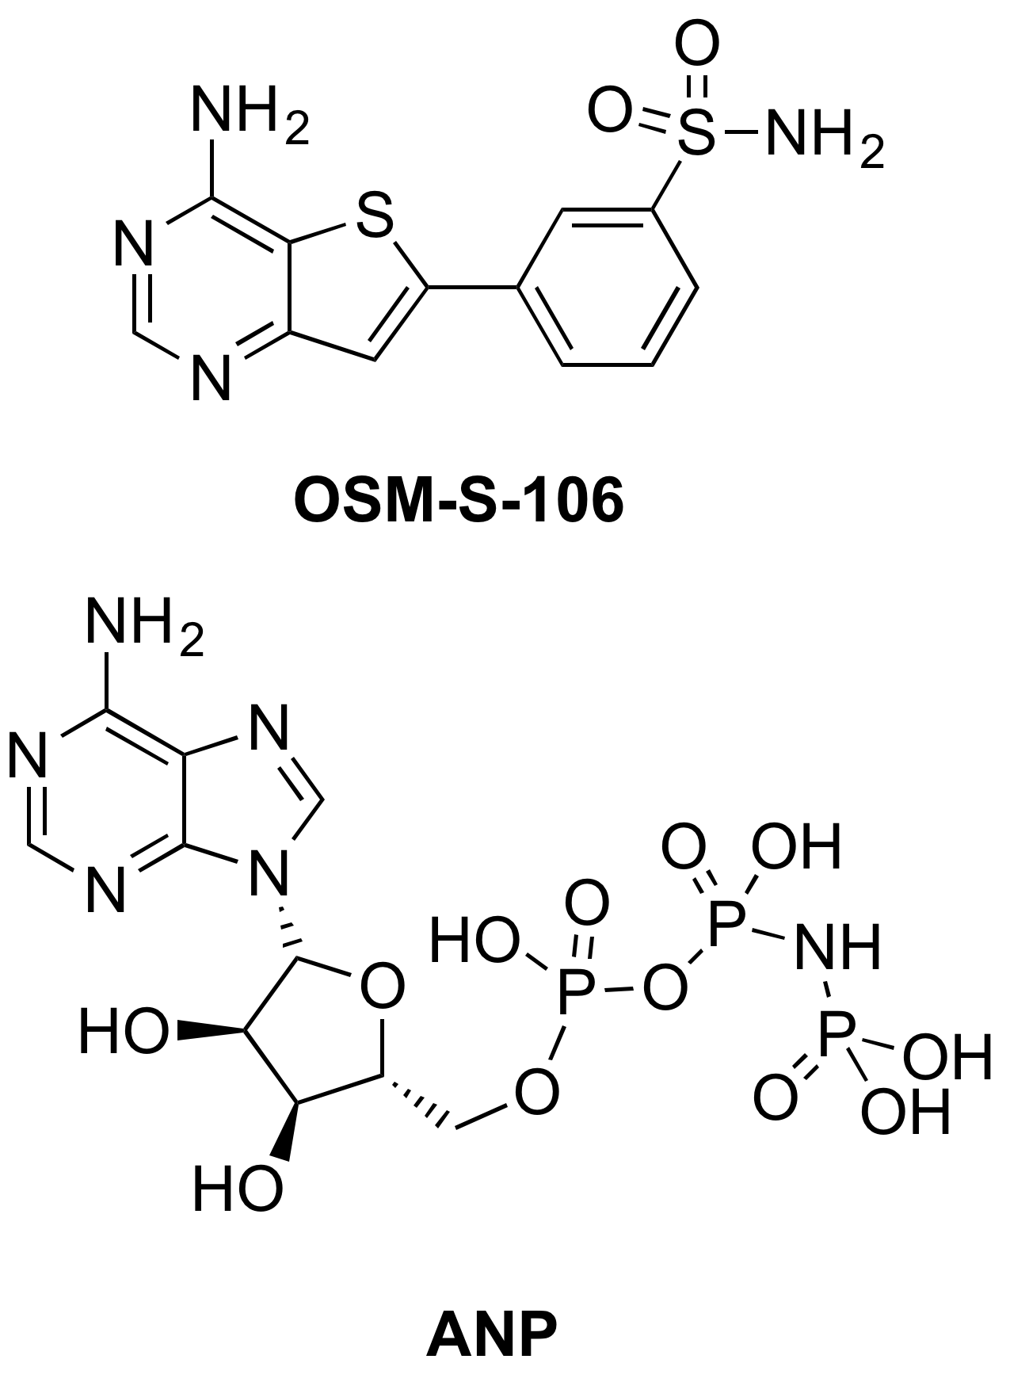
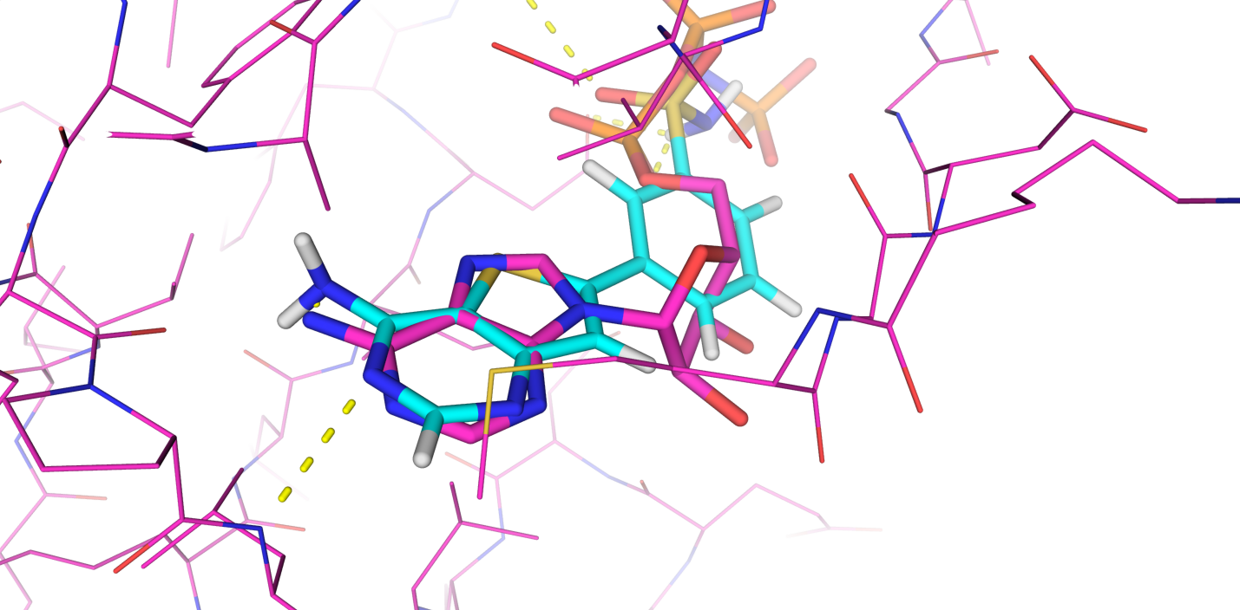
22/55
Example Input. Vito Spadavecchio
Docked with pCLK1
June 3rd 2017
Vito knows the inputs are needed, now
They can change the direction of the project and may be acted upon
They are accompanied by full details of methods used
They are provided freely, without complex contractual negotiations
They are good, and are immediately valued
Vito works in the private sector
Vito can walk away tomorrow if he wishes
Efficient from point of view of funding agencies
But still a very human-human interaction
https://github.com/OpenSourceMalaria/OSM_To_Do_List/issues/503

Slide 23
23/55
Report Card: Interoperable?
17/18
C–
Relatively easy to have inter-operable data, platform, standards
More difficult to have inter-operable procedures
Many legacy format preferences, e.g. Chemdraw, Office, PDF

Slide 24
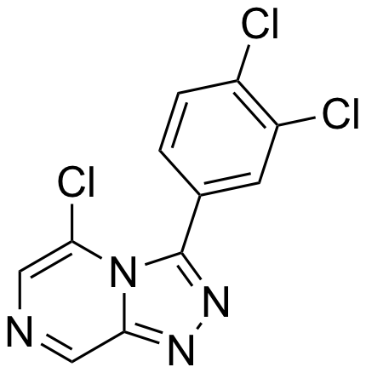
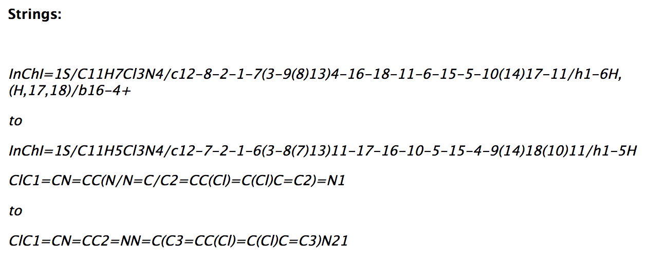
24/55
Machine-readability Still Rudimentary

Slide 25
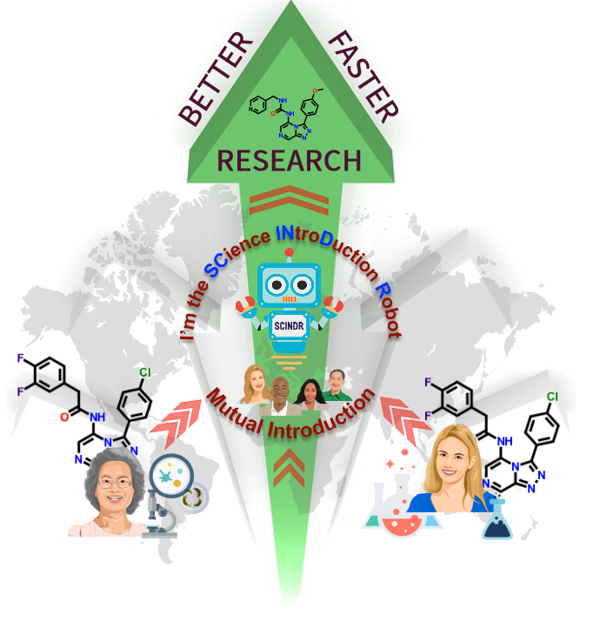

25/55
Should Help People Make Connections
What you’re working on
connects to
What else is out there
It’s called
The Science Introduction Robot
or, umm,
SCINDR
Research Ideas and Outcomes 2: e9995 (27 Jul 2016). DOI: 10.3897/rio.2.e9995
Luc Patiny’s lab notebook C6H6: Mag. Res. Chem., 2018, 56, 520–528.

Slide 26
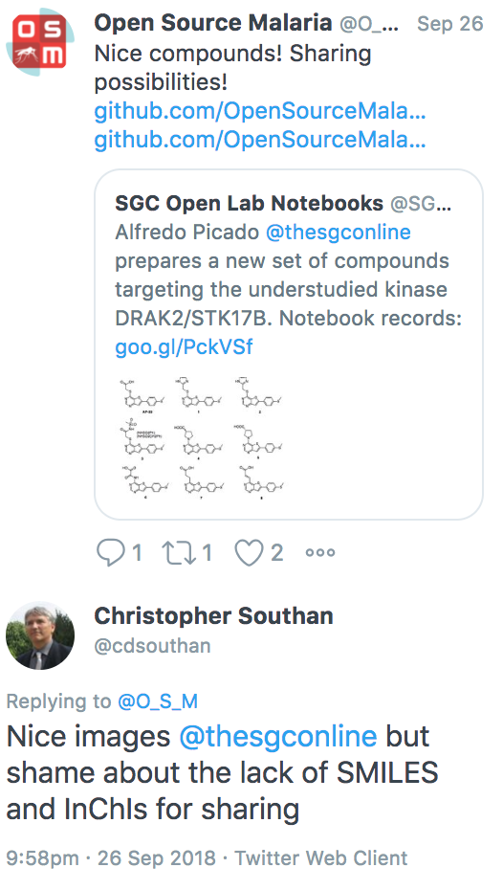
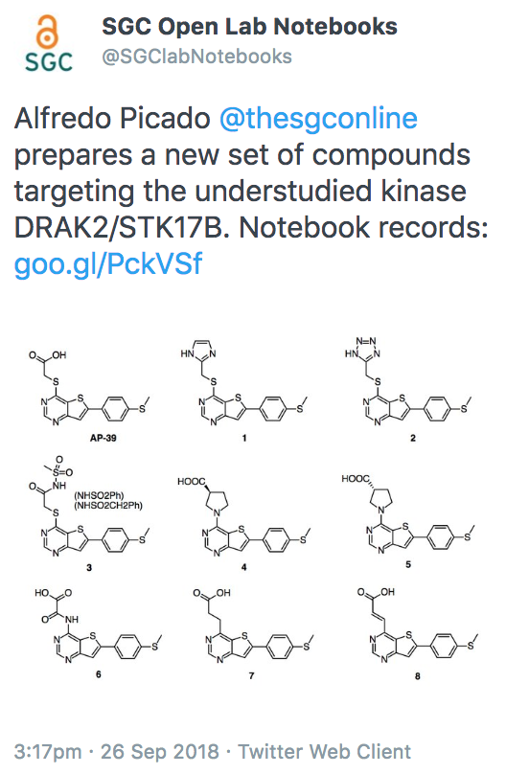
26/55
17/18
Still too easy to miss relevant work

Slide 27
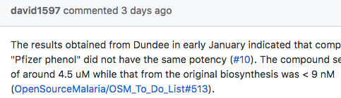
Example of What Else is Missing
27/55
Over-arching problem: the platform doesn’t understand molecules, and doesn’t understand us talking about molecules.
Got: Understands and cross-links discussion pages. Useful.
Blah blah MOL#56 blah blah
Want: Github performs lookup from Master Molecule List. Understands, and inserts metadata

Slide 28
28/55
Report Card: Re-useable?
17/18
D
Licence of the project (clearly) stated: CC-BY-4.0
Much raw data/recipes available and may be reused (and have been)
but lots of gaps
…and inexhaustible supply of OSM molecules, anyone?

Slide 29
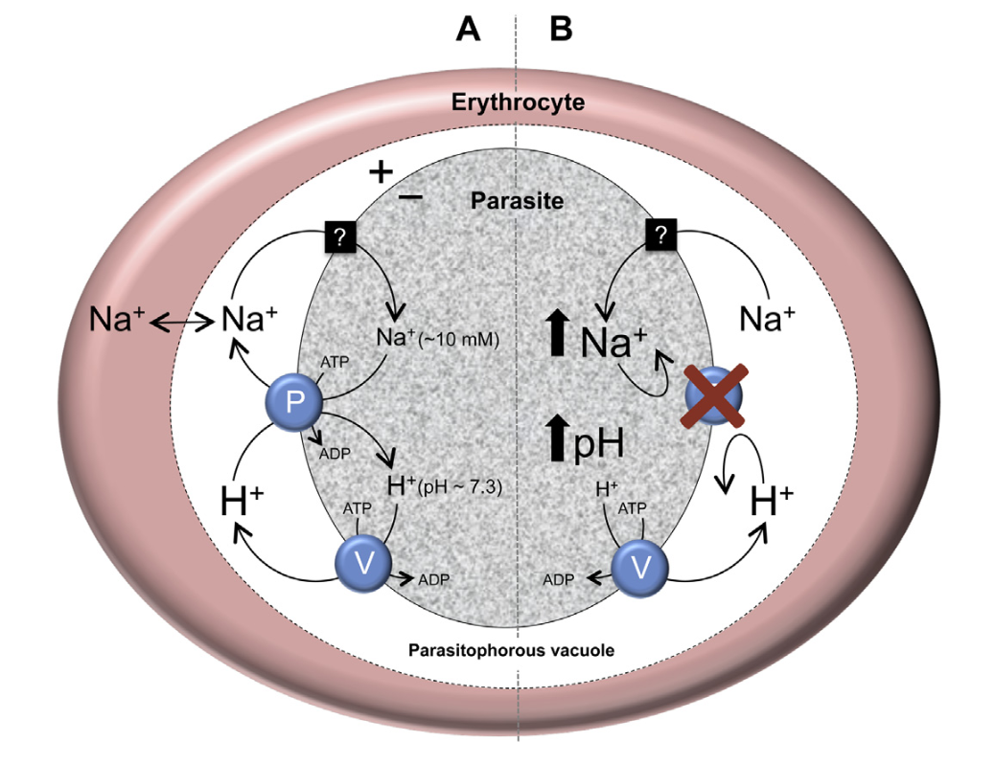
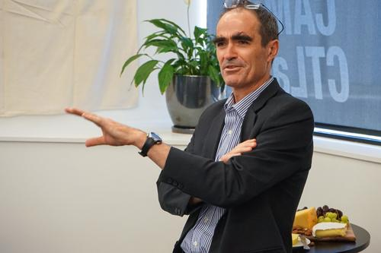
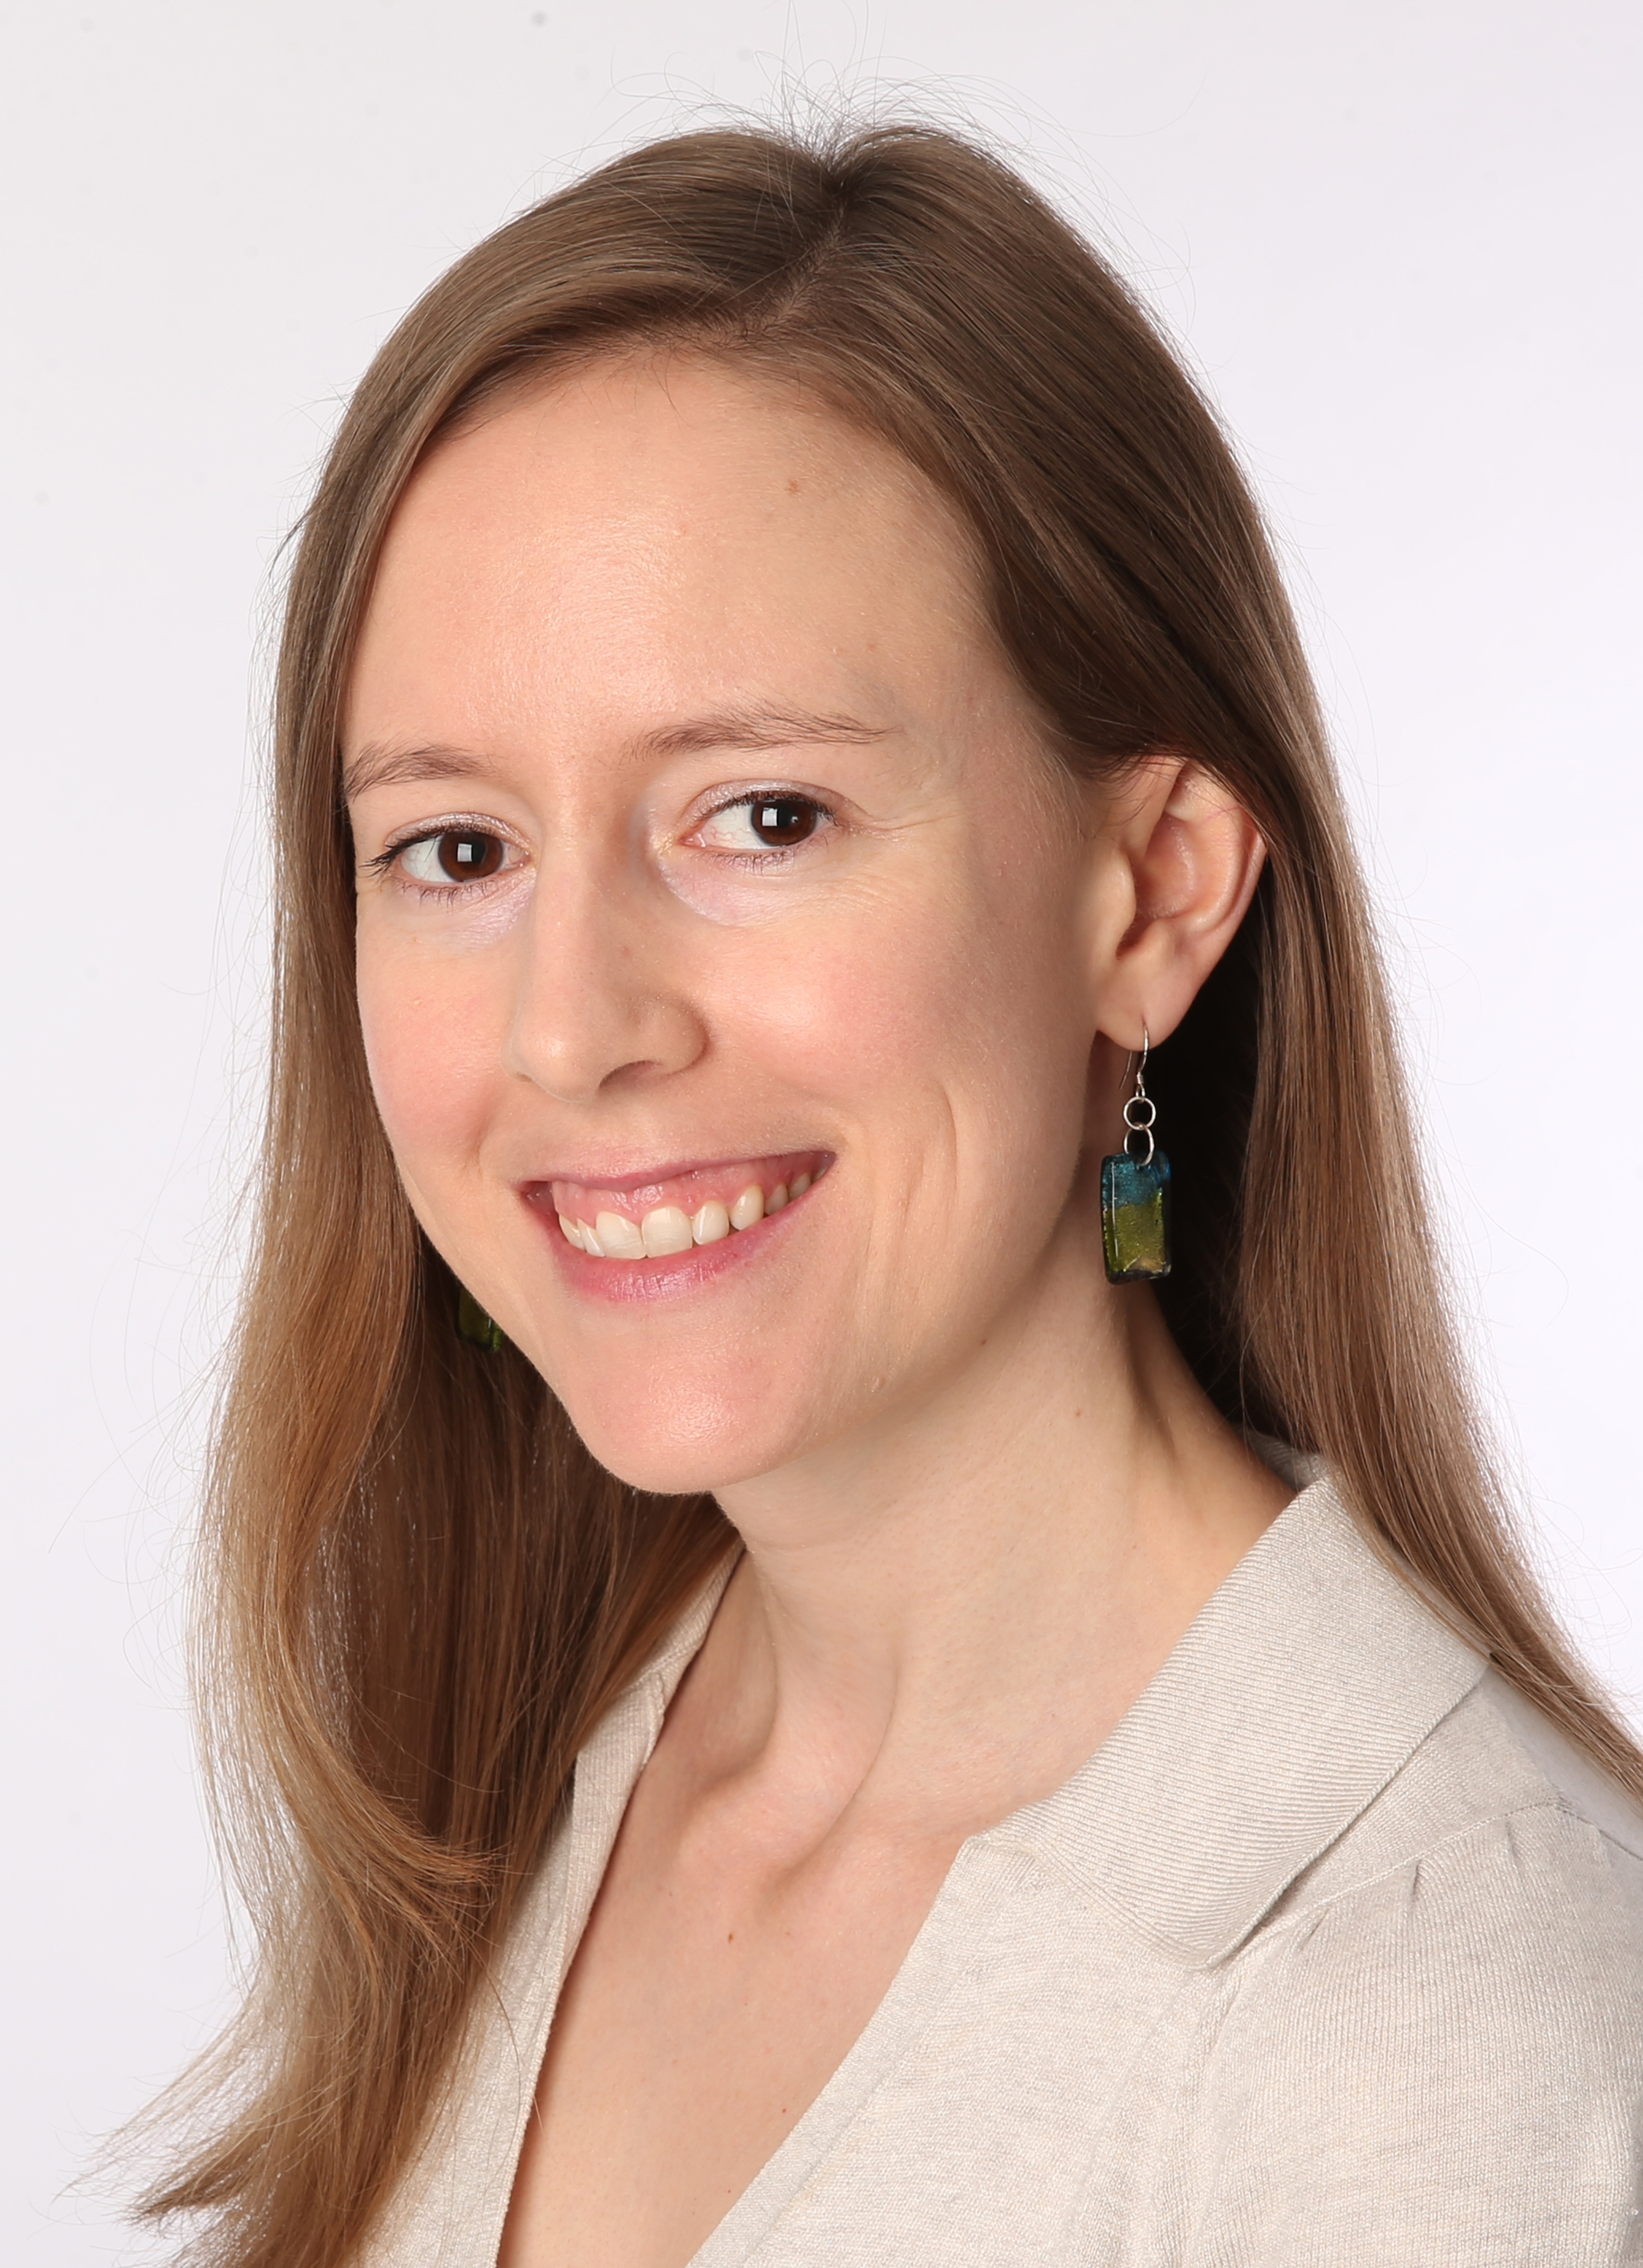
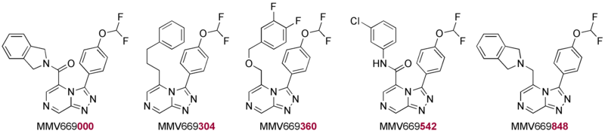
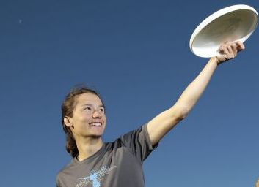
Example: Mechanism of Action
29/55
Current
The malaria parasite cation ATPase PfATP4 and its role in the mechanism of action of a new arsenal of antimalarial drugs
N. J. Spillman and K. Kirk,
Int. J. Parasitol. Drugs Drug Res. 2015, 5, 149–162
(10.1016/j.ijpddr.2015.07.001)
Kiaran Kirk
Adele Lehane
Adelaide Dennis
inactive
280 nM
356 nM
185 nM
114 nM
Whole-cell potency correlates with activity in ion regulation assay

Slide 30
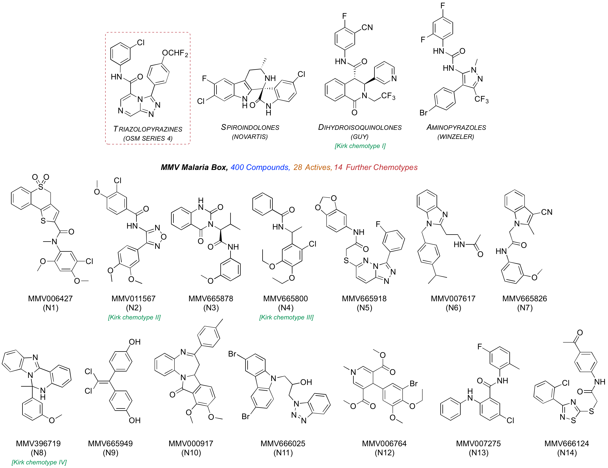
One Lock, So Many Keys
30/55
http://malaria.ourexperiment.org/the_osm_blog/11547

Slide 31
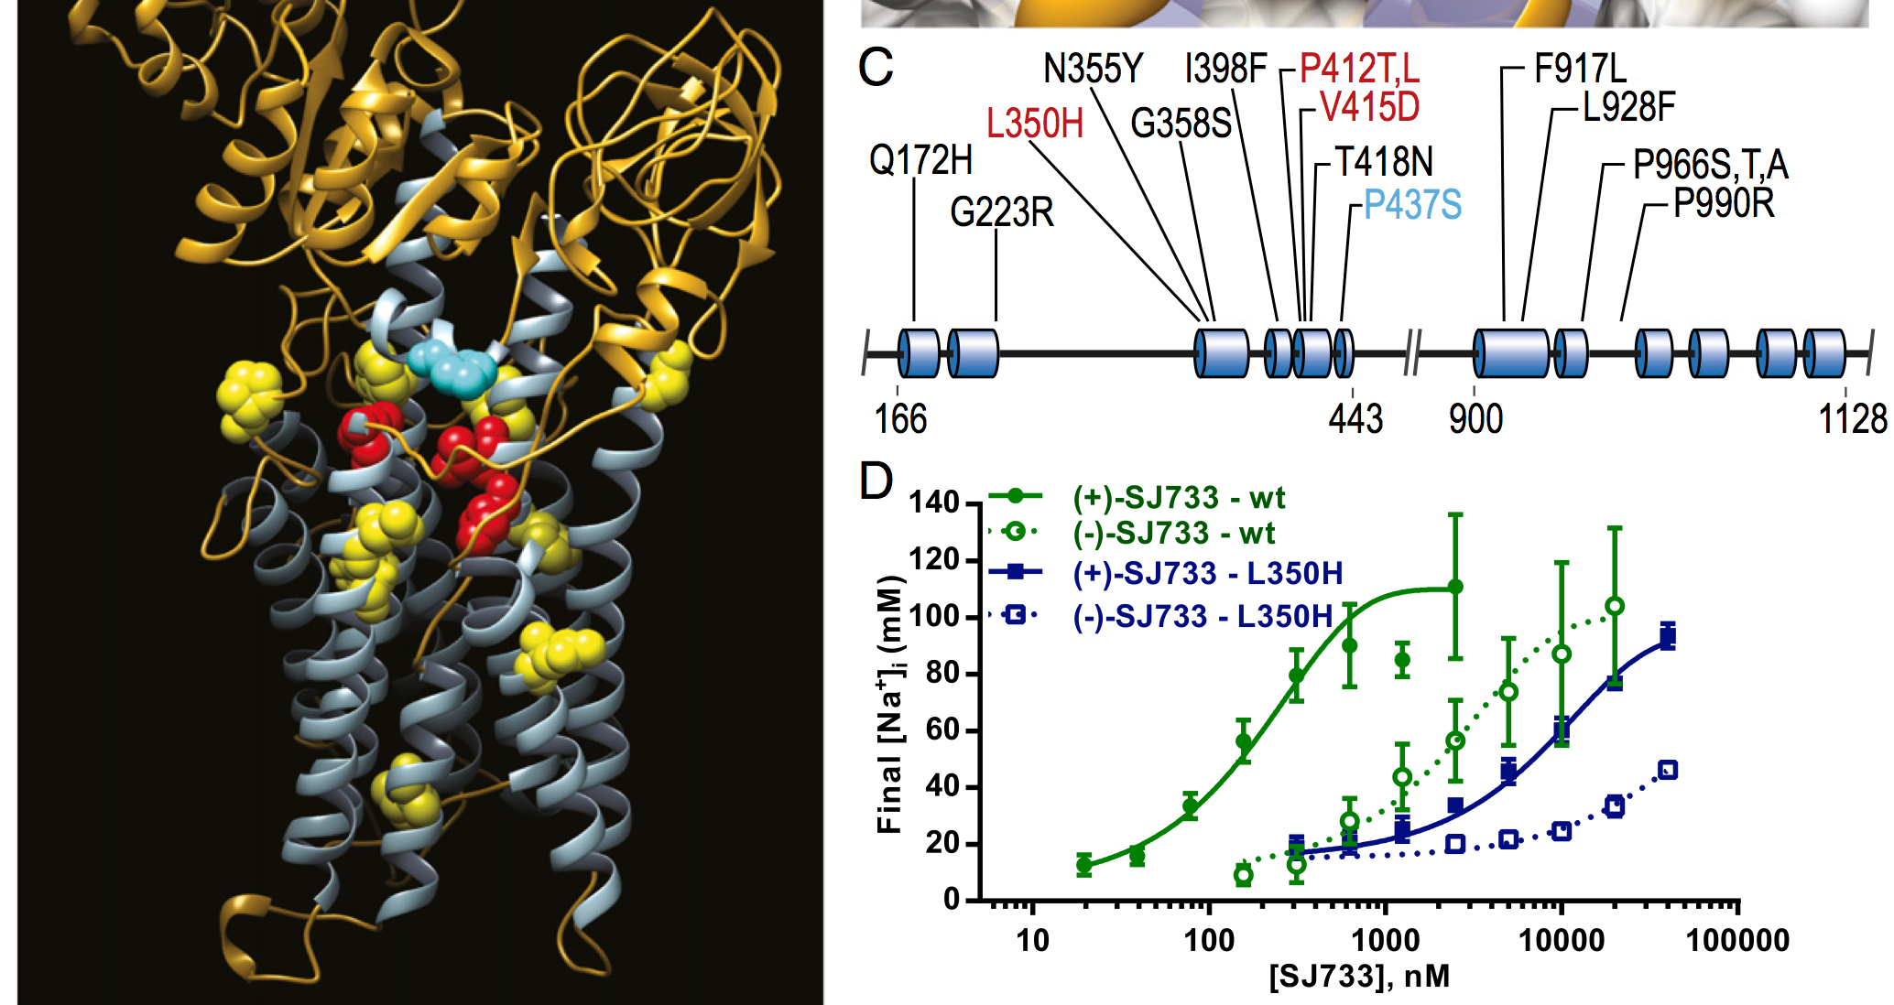
31/55
In silico model of target, creation of resistance
Jimenez-Diaz et al. PNAS 2014, 111, E5455–E5462 (10.1073/pnas.1414221111)

Slide 32
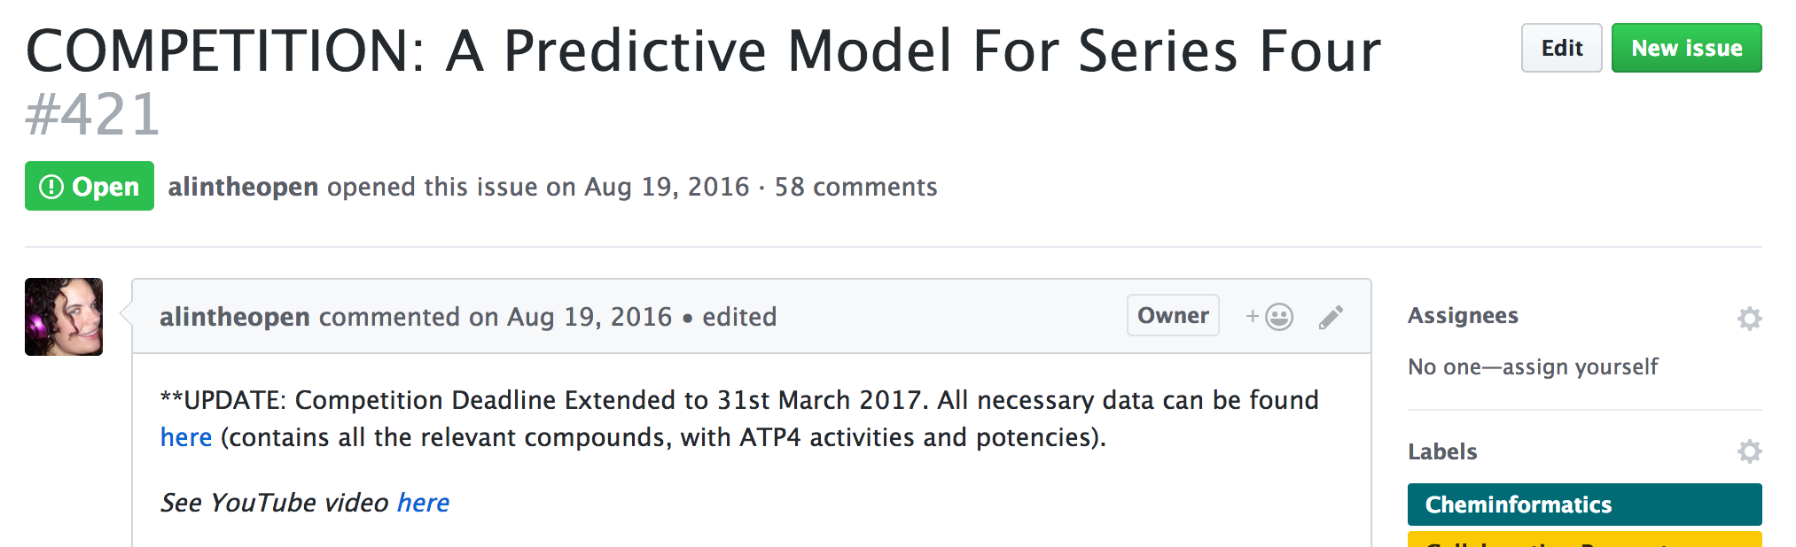
32/55
Wisdom of the Crowd. Nearly.
17/18
Six models, all with different approaches
Different abilities to predict actives from unpublished dataset
Ranked, prizes awarded
All submitters want to work together to refine models openly
https://tinyurl.com/OSM-ToDo
#538

Slide 33
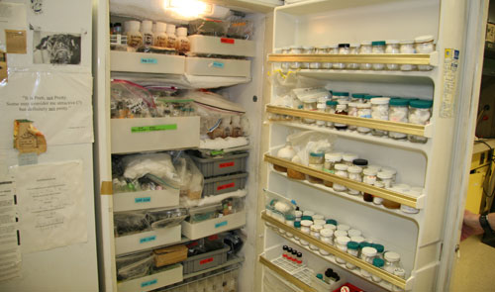
33/55
Recipes, sure, but: Re-useable samples?
http://cenblog.org/2009/09/whats-in-your-fridge/

Slide 34
34/55
What about: Storifiable
17/18
E
Still too hard to keep The Story So Far updated
Presents small but powerful barrier to external, autonomous inputs

Slide 35
Most Recent Physchem/Clearance Data
35/55
Series 3

Slide 36
36/55
What about: Correctable
17/18
B
As with any project, mistakes can be made and must be corrected
An immediately-online project must ensure good data percolate through
..but if the data have already been mined…

Slide 37
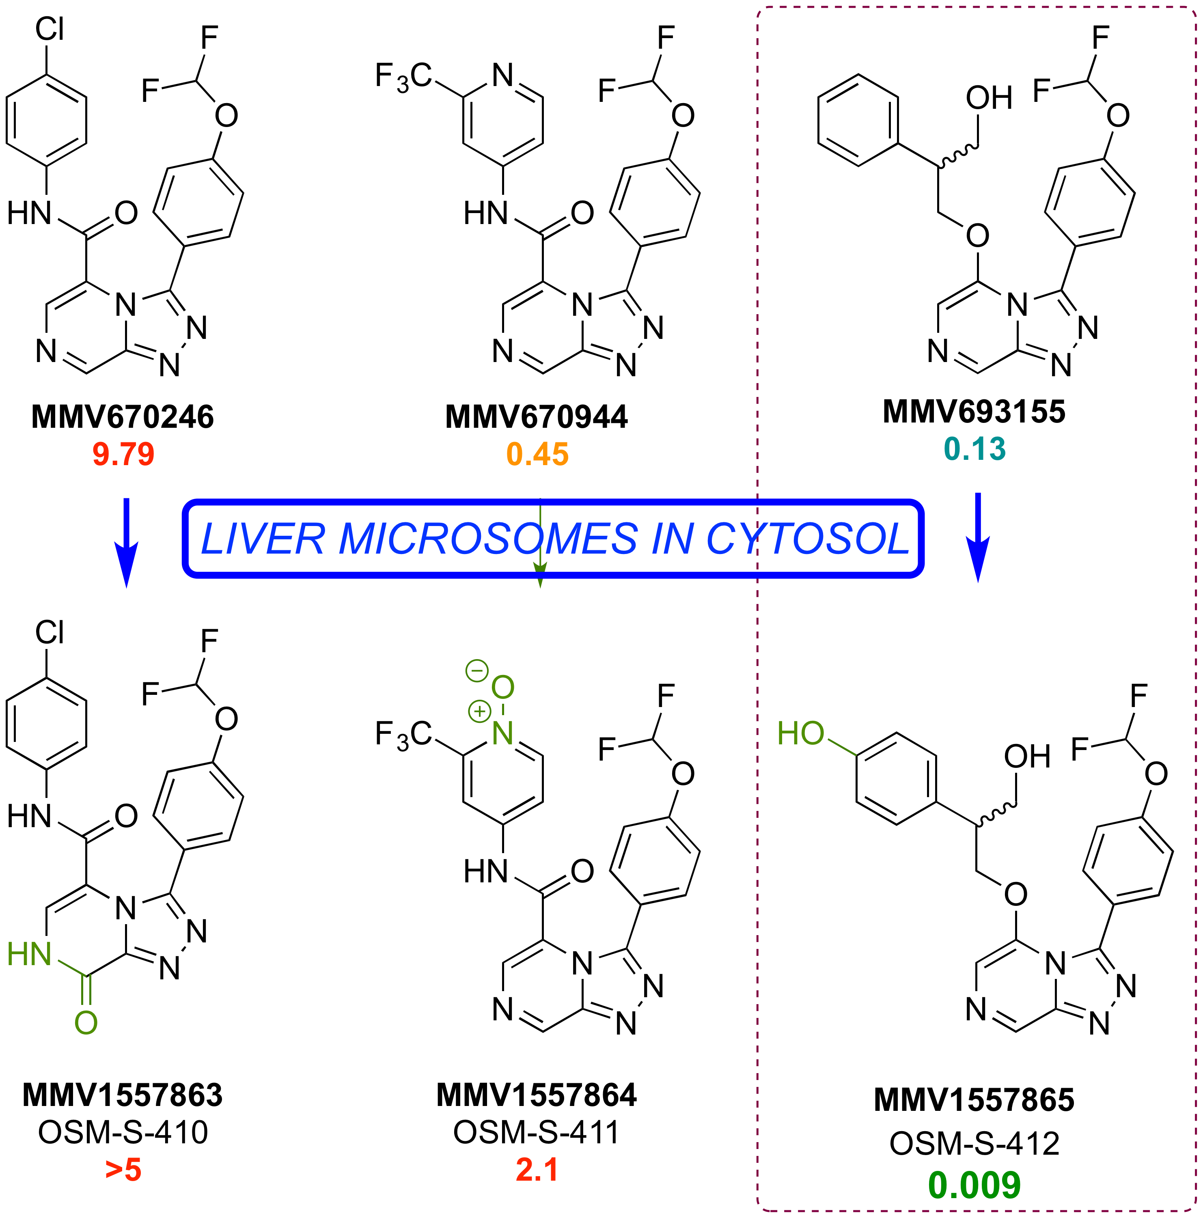
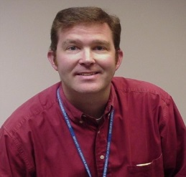
Big Inputs Come From Big Pharma
37/55
17/18
Scott Obach, Pfizer
https://tinyurl.com/OSM-ToDo
#513

Slide 38
SNAFUs Resolved in Public View
38/55
17/18

Slide 39
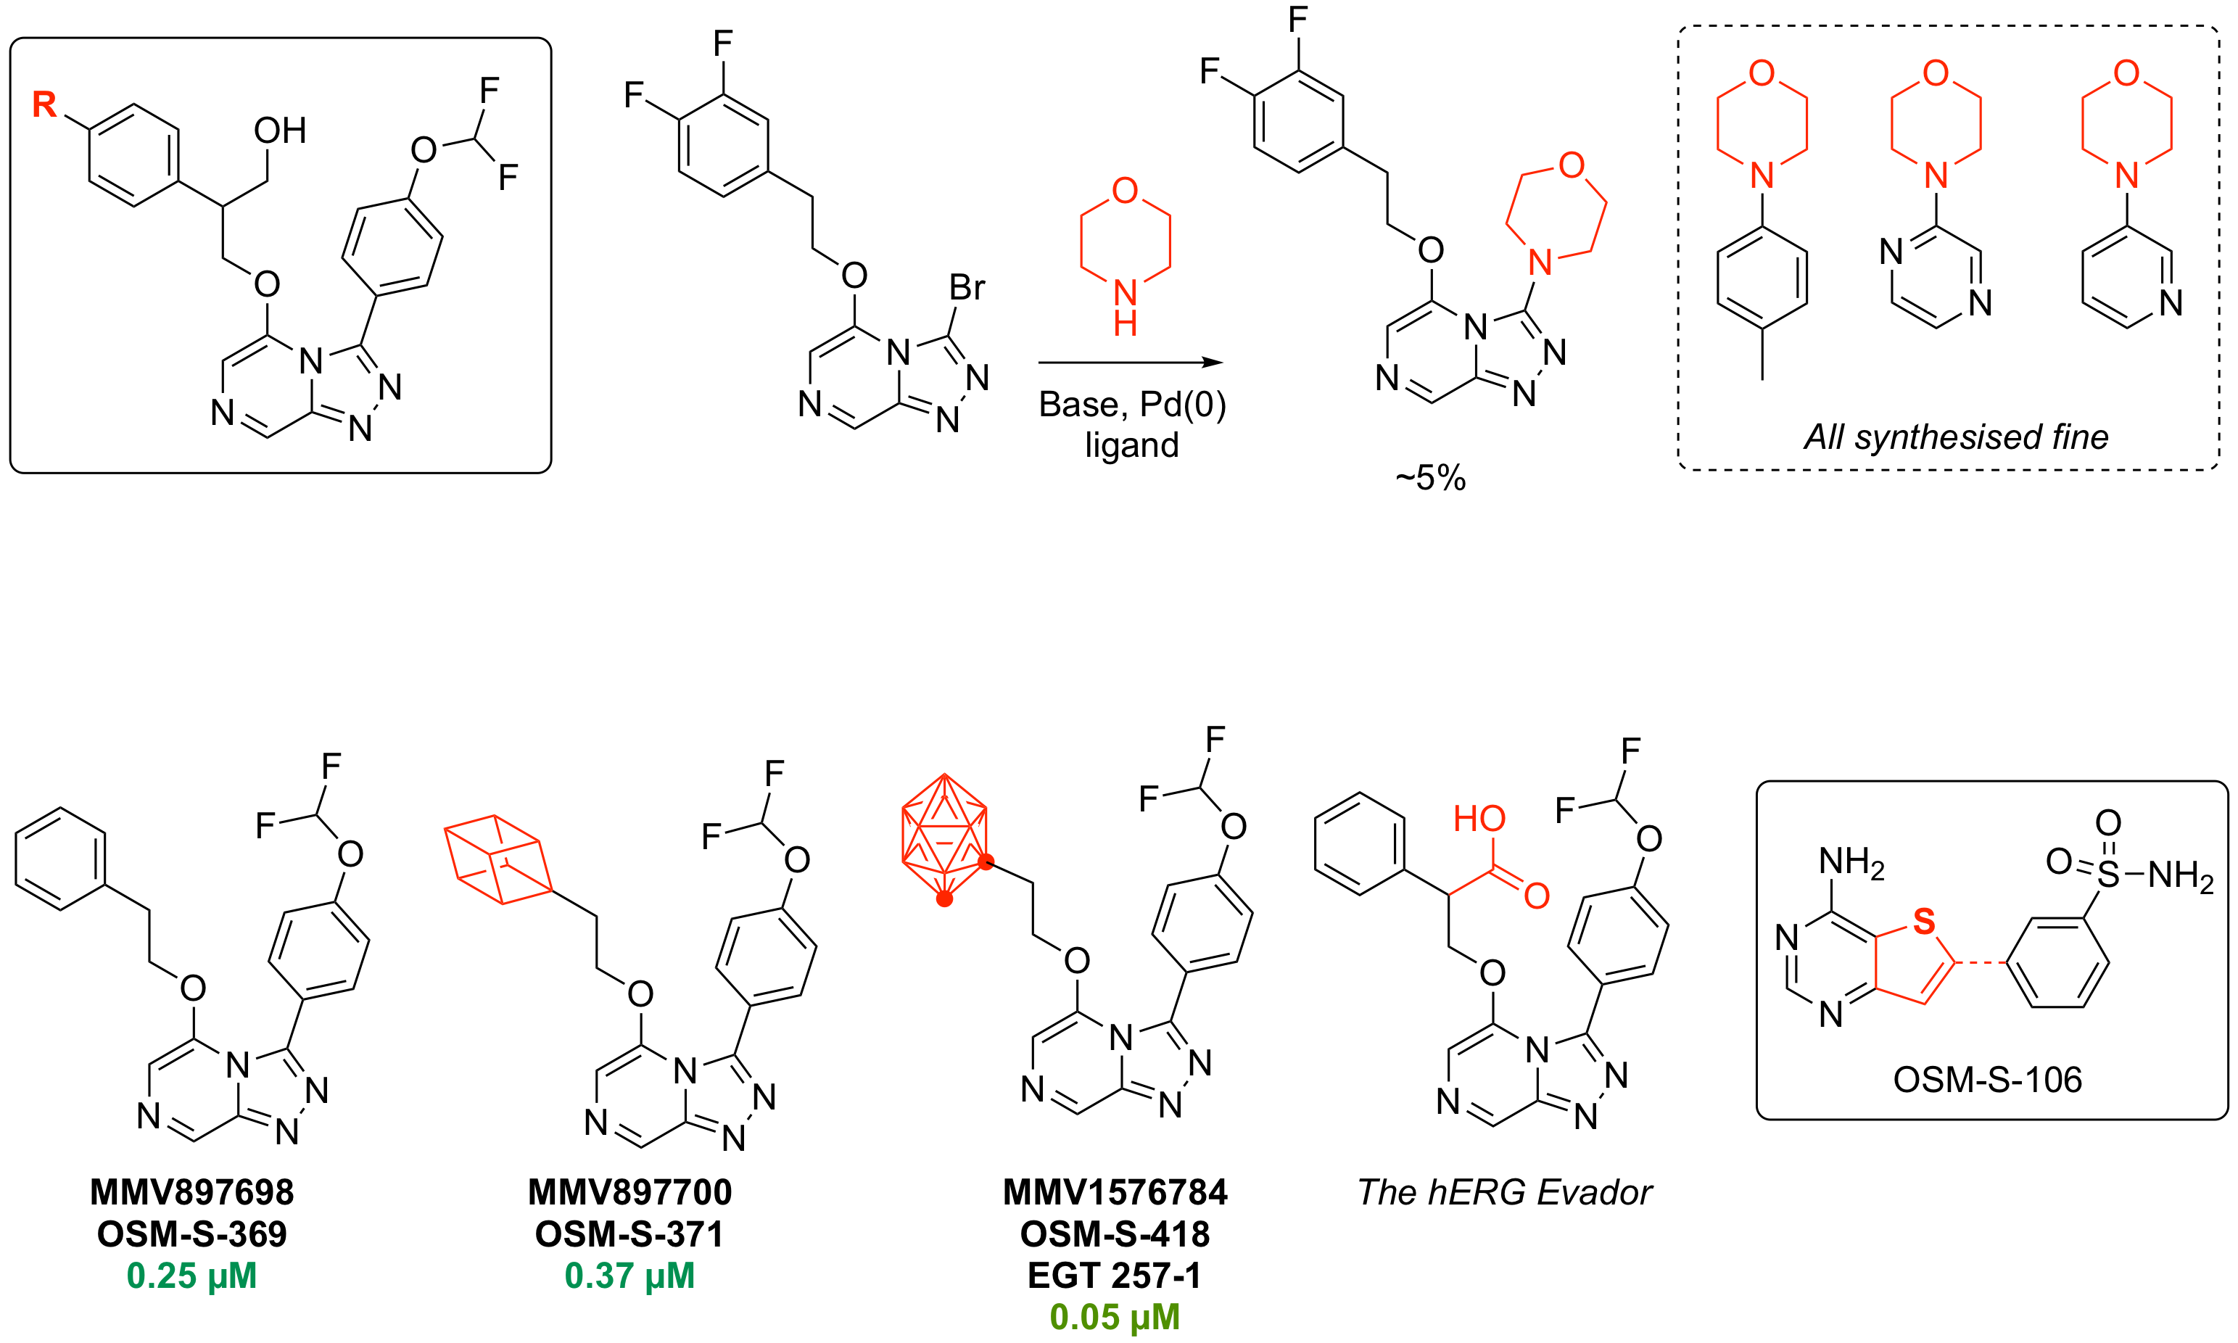
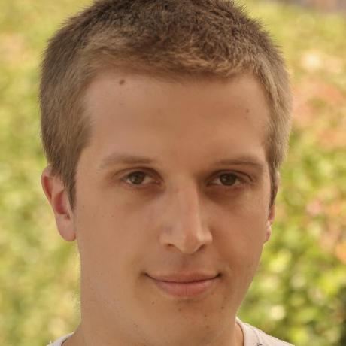
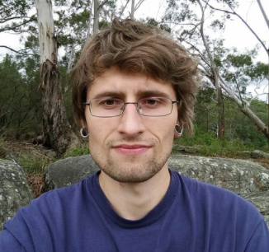
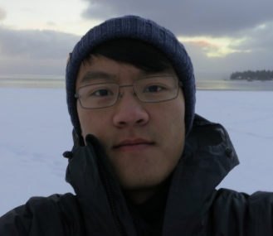
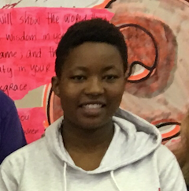
Currently in OSM-Sydney
39/55
David Smith
Marat Korsik
Ed Tse
Tha Bhebhe

Slide 40
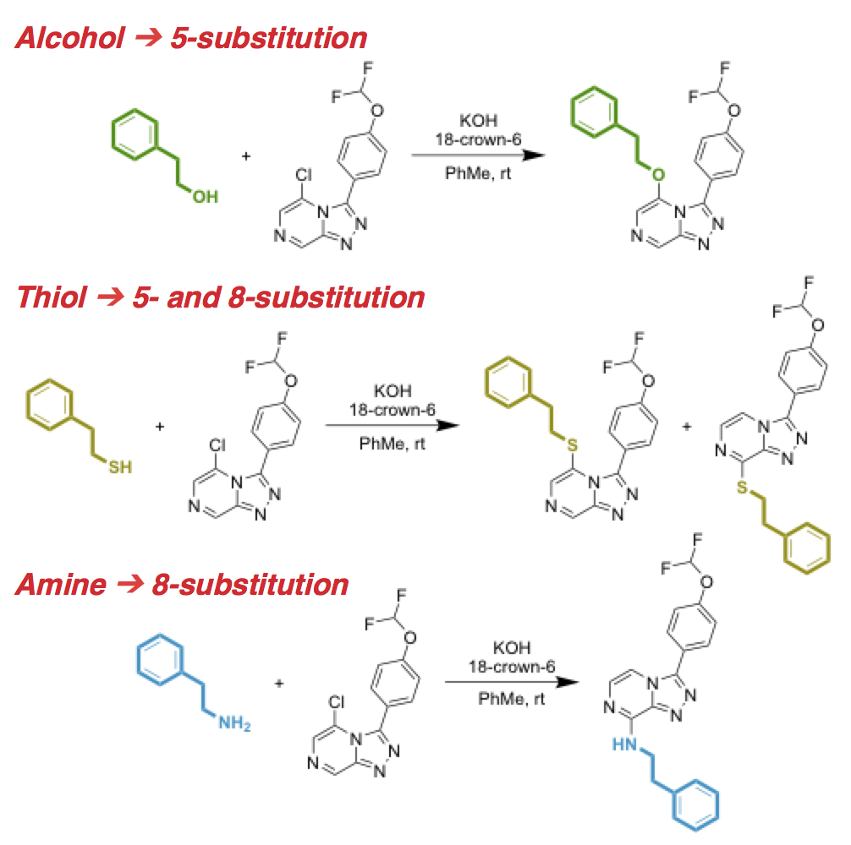
40/55
17/18
An Unexpected Reaction Outcome

Slide 41
41/55
What about: Cloneable
17/18
B+
If something works, it ought to be easy to replicate the structure

Slide 42

New: OS Mycetoma
42/55
1. The Drugs for Neglected Diseases Initiative (DNDi) considers open source as best option
2. First screen has yielded first new hits
3. Feb: started new open source campaign
CENSORED
https://upload.wikimedia.org/wikipedia/commons/thumb/5/59/Madura_foot..JPG/1024px-Madura_foot..JPG

Slide 43


43/55
Fenarimols: A New Hope?
PLoS NTD 2018, 12(4): e0006437.

Slide 44



Maybe not…
44/55
https://github.com/OpenSourceMycetoma/Series-2-Aminothiazoles

Slide 45
45/55
What about: Economically Viable
F, heading quickly towards A+
Incentives help.
If openness ruins prospects for economic development
or
If openness ruins a perceived competitive advantage
then the incentive is gone.
The challenge: show
Openness makes research better/faster
Open research can lead to big scale manufactured outcomes that impact society
These two things majorly affect drug discovery

Slide 46


46/55
Patents Aren’t Necessary
Penicillin, The Polio Vaccine
ASAQ/Coarsucam
Bompart F, Kiechel JR, Sebbag R, Pecoul B (2011) Innovative Public-Private Partnerships to Maximize the Delivery of Anti-malarial Medicines: Lessons Learned from the ASAQ Winthrop Experience. Malaria Journal 10:143. doi:10.1186/1475-2875-10-143
Fexinidazole
Torreele E, Bourdin Trunz B, Tweats D, Kaiser M, Brun R, Mazué G, et al. (2010) Fexinidazole – A New Oral Nitroimidazole Drug Candidate Entering Clinical Development for the Treatment of Sleeping Sickness. PLoS Negl Trop Dis 4(12): e923. doi:10.1371/journal.pntd.0000923

Slide 47



47/55
Application Across Pharma
US$3M awarded to me and 4 colleagues in 2015 for creation of Open Source Pharma Foundation. Money to be spent in India to support any open work. Now incorporated, commencing activities.
PLoS Med. 2017, 14(4): e1002276
The Guardian, April 19th 2017

Slide 48




48/55
Other Financial Models in Pharma
Independent Mobilization of Donor Funds
Advance Market Commitments & International Financing Facilities
R. Atun, F. M. Knaul, Y. Akachi and J. Frenk, Lancet 2012, 380, 2044–2049
Levy on Airline Tickets

Slide 49






49/55
Other Financial Models in Pharma II
Priority Review Vouchers
P. Doshi, BMJ 2014, 349:g4665. DOI: 10.1136/bmj.g4665
Prizes
A. Banerjee, A. Hollis and T. Pogge, Lancet 2010, 375, 166–169. DOI: 10.1016/S0140-6736(09)61296-4
Crowdfunding
J.-M. Fernandez, R. M. Stein and A. W. Lo, Nature Biotech. 2012, 30, 964–975. DOI: 10.1038/nbt.2374

Slide 50


49a/55
Wouldn’t it be nice…

Slide 51


50/55
The Proposed (Overlooked) Strategy
Diverse Funding of Open Source Drug Discovery
|
Make Money Back
|
Drug Goes Generic

Slide 52

51/55
If you’re interested in all this…

Slide 53



52/55
Some Family History
A financial reward in proportion to contribution,
after demonstration of effectiveness
Samuel Crompton
1753–1827
https://upload.wikimedia.org/wikipedia/commons/f/fd/Mule-jenny.jpg
https://en.wikipedia.org/wiki/Samuel_Crompton#/media/File:Samuel_Crompton_portrait.jpg

Slide 54



53/55
Inclusiveness: Future Role of Private Sector
“…organizations of all types are increasingly taking advantage of the many benefits open source can bring in terms of cost-effectiveness, better code, lower barriers of entry, flexibility, and continual innovation.”
World Bank Blog https://blogs.worldbank.org/, Vivien Deparday, June 2017
“We conservatively estimate GFDRR’s return on investment (ROI) for GeoNode to have been at least 200% — with an emphasis on “conservative”. … the long-term and indirect ROI is much greater than that, and continues to grow”
A Case Study on Institutional Investments in Open Source, World Bank and Global Facility for Disaster Reduction and Recovery (GFDRR), 2017
$371M VC investments in OS software in Q1 2017 alone
Jason Rowley, CrunchBase, April 2017

Slide 55




54/55
New Problems Need Radical Approaches

Slide 56










Sydney: Alice Williamson, Ed Tse, Michael Woelfe, Paul Ylioja, Murray Robertson, David Smith, Kat Badiola, Jimmy Cronshaw, Zoe Hungerford, Laura White, Clara Chen, Angela Butera, Matin Dean, Althea Tsang, Jo Ubels, Tom MacDonald, Matt Tarnowski, Peter Turner, Carmen Tran, Inga Topolnicki, Haochuan Mao, Tianyi Zheng, Jasper Tyler, Mathamsanqa Bhebhe, Marat Korsik MMV: Tim Wells, Paul Willis, Jeremy Burrows GSK: Javier Gamo, Felix Calderon, Lluis Ballell, Julia Castro-Pichel, Carlos Alemparte, Benigno Crespo Sydney Grammar School: Malcolm Binns, Erin Sheridan, the boys WHO/TDR: Piero Olliaro Syncom B.V.: Jean-Paul Seerden Massachusetts College of Pharmacy and Health Sciences: Chase Smith and students Dundee: Irene Hallyburton Southampton: Jeremy Frey and team ChEMBL: John Overington, Iain Wallace, George Papadatos ANU: Kiaran Kirk, Adele Lehane, Adelaide Dennis OSDD India: Sanjay Batra, Soumya Bhattacharyya Griffith: Vicky Avery, Sandra Duffy, Sabine Fletcher, Mark Coster and student teams Monash: Sue Charman, Karen White, Darren Creek, Anubhav Srivastava Melbourne: Stuart Ralph, James Pham Basel: Sergio Wittlin Edinburgh: Patrick Thompson, Eduvie Omene, Devon Scott, Tom Foley Pfizer: Scott Obach, Christine Orozco Lawrence University: Stefan Debbert and students Haverford College: Robert Broadrup Karolinska Institute: Sabin Llona-Minguez University of British Columbia: Corey Nislow, Marinella Gebbia, Anna Lee Asclepia: Frederick DeRoose ExScientia: Willem van Hoorn UCSD: Stephan Meister, Elizabeth Winzeler St Jude’s Hospital: Kip Guy, Julie Clark Other Online: Chris Southan, Jonathan Baell, Chris Swain, Egon Willighagen, Vito Spadavecchio, Mandrake Fernflower, Ho Leung, and many others

